Slide 1
Job Applications and Interviews
Dr. Xiao Qin
Auburn University http://www.eng.auburn.edu/~xqin
xqin@auburn.edu

Slide 2
Job Search Tools
Tool 1: Job Search Websites
Tool 2: An Effective Resume
Tool 3: A List of Positive References
Tool 4: A Well-Written Cover Letter or E-mail Message

Slide 3
Job Search Methods
Method 1: Create a Network of Contacts
Contact Auburn CSSE Alumni
Create a LinkedIn Account
Method 2: Keep Contact Records for Each Organization
Method 3: Attend Auburn Career Fairs
Method 4: Respond to Want Ad

Slide 4


Two Job Websites for CSSE Students
indeed.com
dice.com
More websites: www.ebizmba.com/articles/job-websites

Slide 5
Tips on Your Resume
Begin with your contact information.
Use category headings such as Objective, Professional Highlights, Education, Training, Skills, Professional Associations and Organizations, and Honors and Awards.
Include volunteer experiences, languages, internships, and certificates that relate to the position.
List your previous responsibilities and results that relate to the job you are seeking and the needs of the organization.
Give examples of your accomplishments and your ability to solve problems.
Provide statistics and numbers that prove your statements.
Reference: Job Seeker’s Workbook
Notes:
Lpage is a page table entry

Slide 6
Tips on Your Resume (cont.)
Research the industry and know what information or keywords would impress an employer in that industry.
Use industry terminology when applicable.
Leave off salary information. Provide it only when requested.
Do not provide names of references on the resume, but include this statement: References Available Upon Request.
Use incomplete sentences that have action verbs and other words with lots of impact.
Be honest, positive, realistic, and specific.
Reference: Job Seeker’s Workbook
Notes:
Lpage is a page table entry

Slide 7
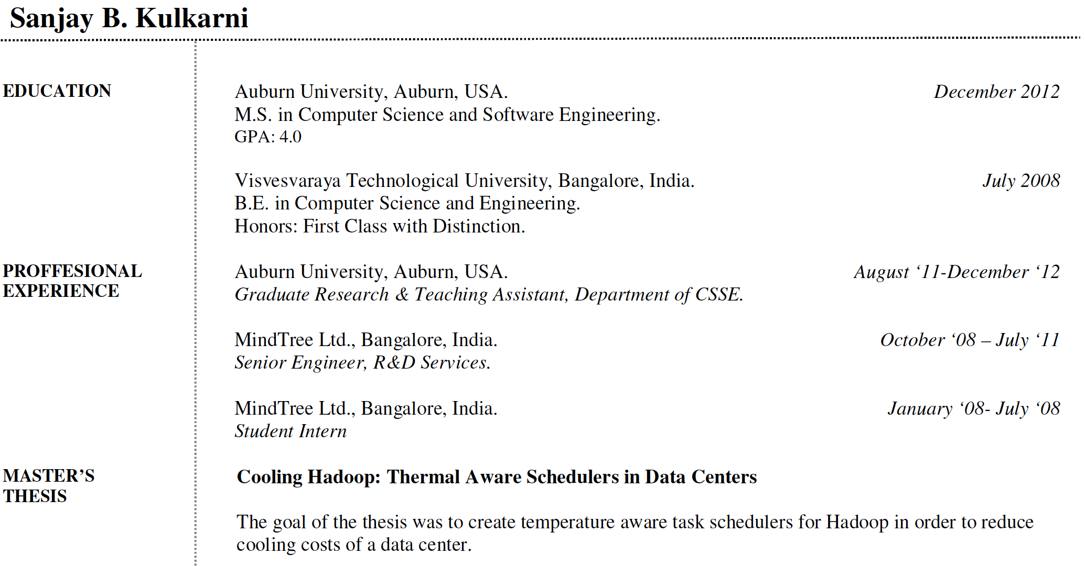
Resume

Slide 8
Sample Resume

Slide 9
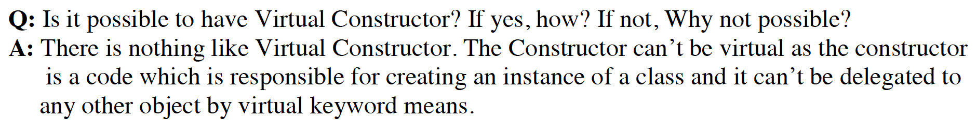
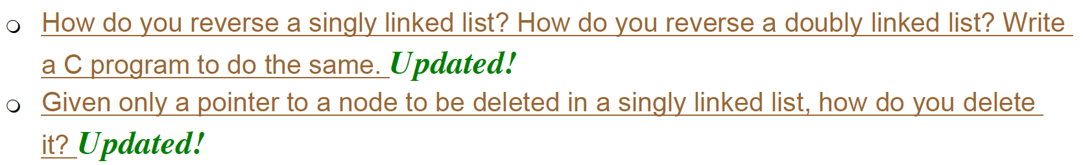
Job Interview Questions
Reference: http://career.guru99.com/top-50-operating-system-interview-questions/
Notes:
Lpage is a page table entry

Slide 10

A Good Book
Notes:
Lpage is a page table entry

